Slide 1


Lesson 5
Functions

Slide 2
Learning Objectives
By the end of this lesson, you will…
Understand how a sequence of code works
Understand what a function is
Understand what a function with an argument is
Understand how to reuse code

Slide 3

Lesson 5
What is a function?
“Make me a cup of tea please”
How do you make a cup of tea?
What steps are involved?
How do we know this?
A function is a command which contains the steps needed to perform a task

Slide 4
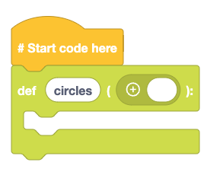
Lesson 5
How does a function work?
We are going to create a function to draw 10 circles in a pattern
Go to Definitions and drag def block into the coding area
In the first blank, type circles this will define the name of the function
We have now created a function. But we need to add code to the function. This is the code that will be ran when the function is called.

Slide 5
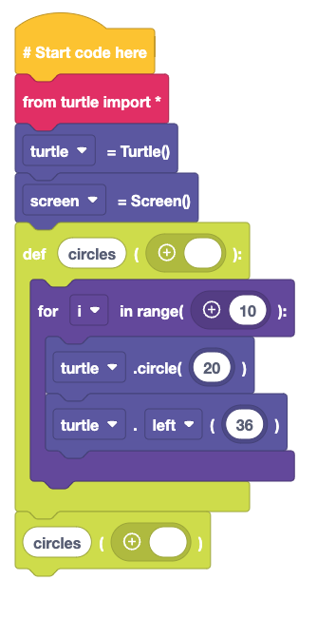
Lesson 5
Using the function
We import turtle as per previous lessons.
The circles function will use a for loop. It will go round 10 times.
It will draw a circle with a radius of 20 pixels, then turn left by 36 degrees (360/10)
We then call the circles function and watch as it automatically draws the pattern.
Run the code, what happens? Does it work as expected?
Can you change it to do something else?

Slide 6
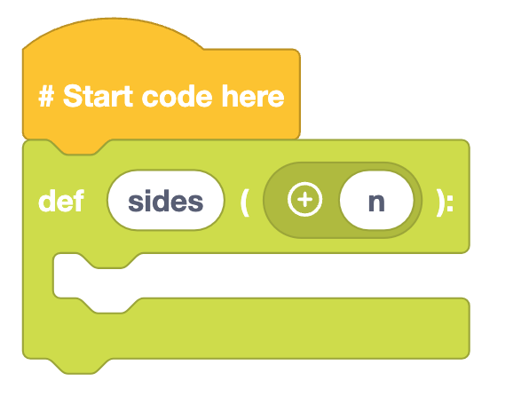
Lesson 5
A function with an argument?
We are going to create a function to draw any shape using Turtle
Go to Definitions and drag def block to the coding area
In the first blank, type sides and in the second type n
The name of the function is sides and it has an extra parameter of n. This is called an argument.
We have now created a function with an argument. The code inside is run when its name is used.

Slide 7
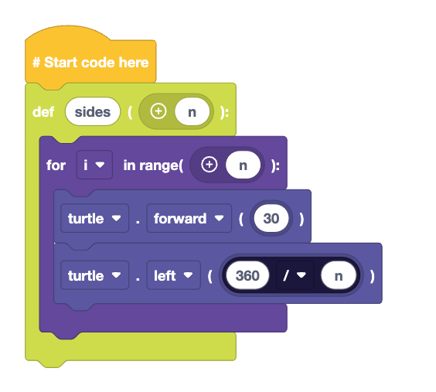
Lesson 5
Code inside the function
Inside of the function we add:
A for loop which uses n to set the range
We also use two turtle blocks to move forward and left
Can you remember what this calculation will do?

Slide 8
Lesson 5
Using a function
Inside a while True loop:
Drag function_name from Definitions
Type sides in the first blank
Into the second blank, drag int(1) from statements
Then drag input() from Statements and place on top of the int() block
For the input block, ask the user “How many sides does this shape have?”

Slide 9
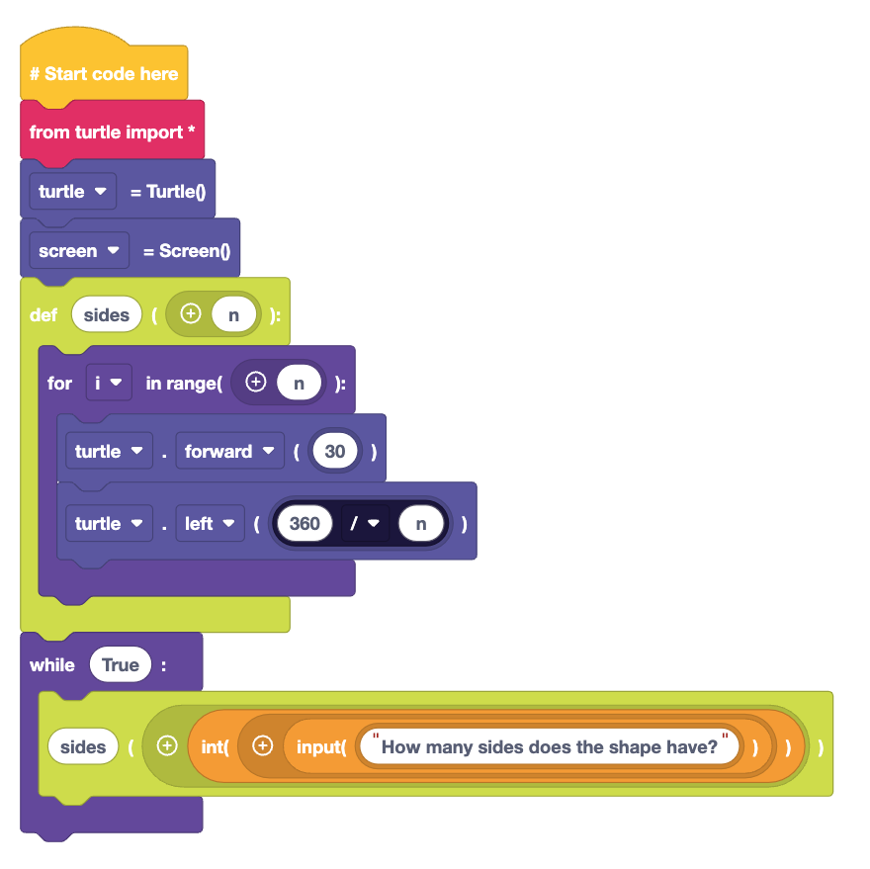

Lesson 5
Importing the turtle blocks
From the import and turtle blocks, we need to drag:
from turtle import *
Turtle = Turtle()
screen = Screen()
Your code should look like this, click to test

Slide 10
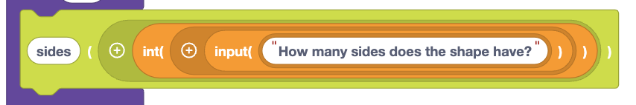
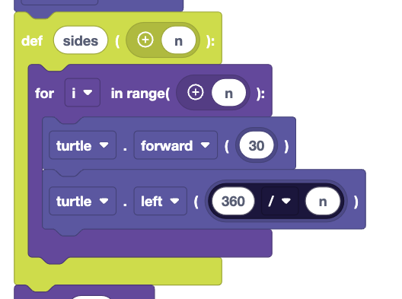
Lesson 5
What happens?
By using the name sides, we call the function.
The user input captures the number of sides the shape has. This is saved to n which is then used to control the for loop.
It also forms part of the calculation to determine the turning angle.

Slide 11
Lesson 5
Why are functions useful?
Functions are powerful tools.
They are subroutines, small sequences of code inside the main code.
We can call the function, and come out of the main code, do the function, then come back to the code.
They enable us to reuse sections of code.
They keep our code tidy, and with fewer lines to write.
In our code we can draw any shape using one section of code.

Slide 12
Plenary
What have we learnt?
How to create a basic function
How to create a function with an argument
How functions can be reused for different outputs

Slide 13
Plenary
Next Lesson
Next Lesson we will use EduBlocks to build our own projects to create patterns using shapes and colours

